Slide 1
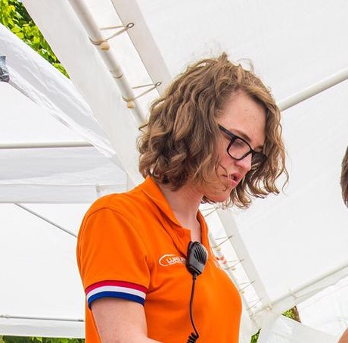
Fien Pockelé
Live in Delft, from Antwerp
Hobbies: gaming, miniature painting, reading
4th year AE, minor Computer Science
2nd choice project
Interested in Aerodynamics

